Slide 1


Weekly Report NTUA 21/2/2020
George Bakas, Ioannis Papakrivopoulos

Slide 2
Status Report
Analysis:
Efficiency and Acceptance:
Parton and Particle
Nominal MC samples
mTT samples → Giannis calculated the corrected xsec
2017 and 2018 we use only the 100—Inf file
MC ‘16 , ‘17, ’18 Comparison:
All Slices Comparison
Mtt slice comparison for 16/17 and 17/18
Nominal MC per slice comparison for 17/18
NTUA HEP Site
HEP Data for TOP-18-013
Building code to make the tables conversion generic
Next week overview and instructions for future use

Slide 3
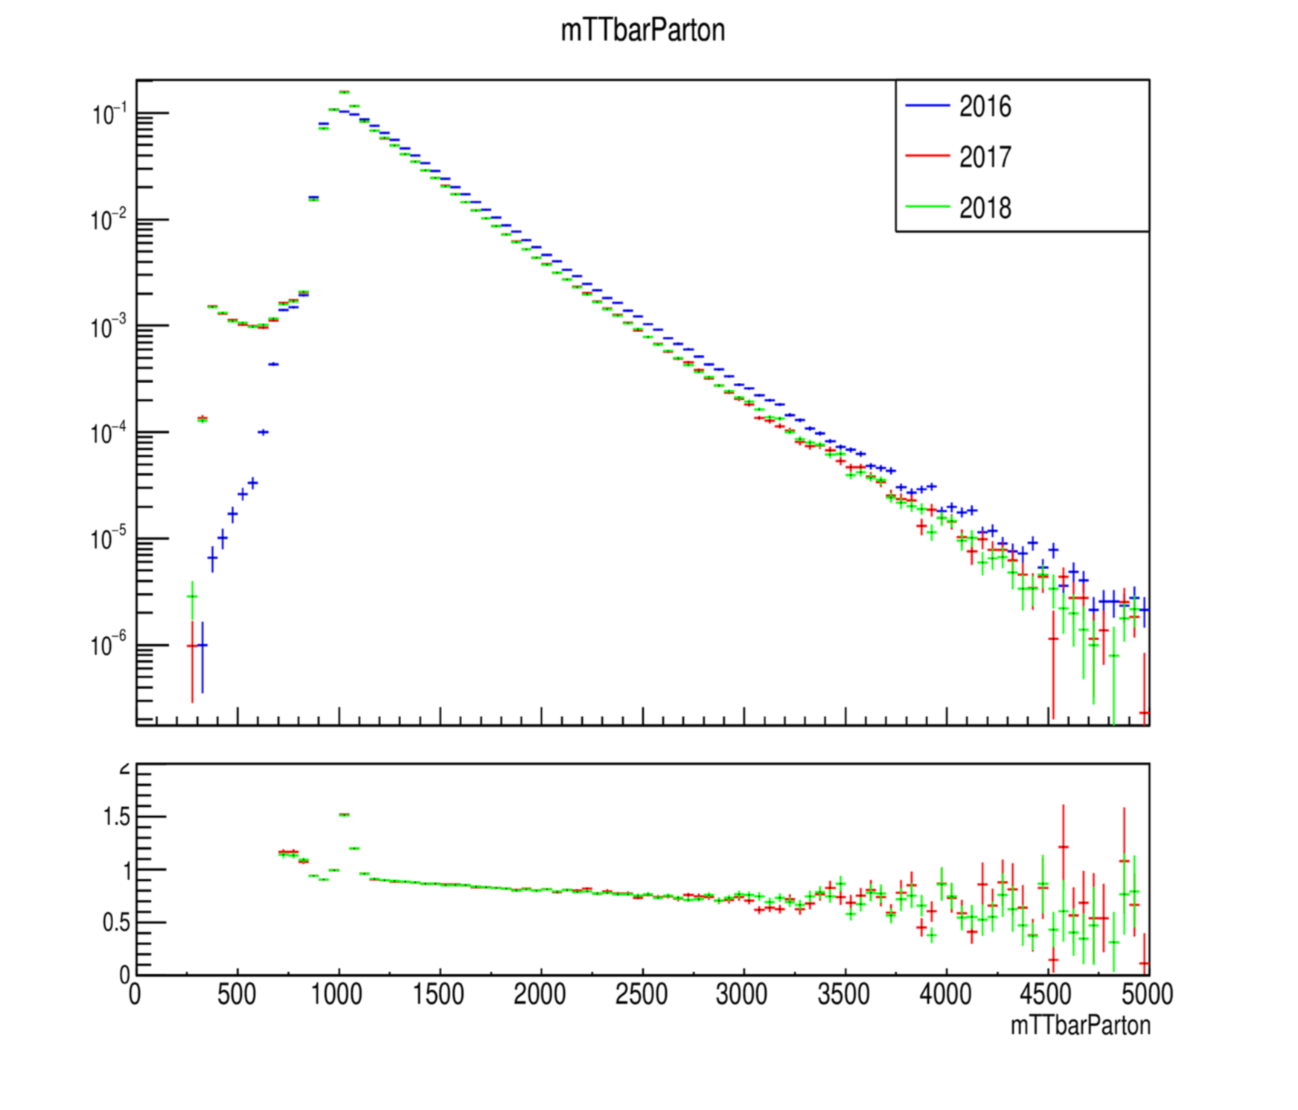
MC Closure tests ’16, ‘17 and ’18 (shape) for mtt files

Slide 4
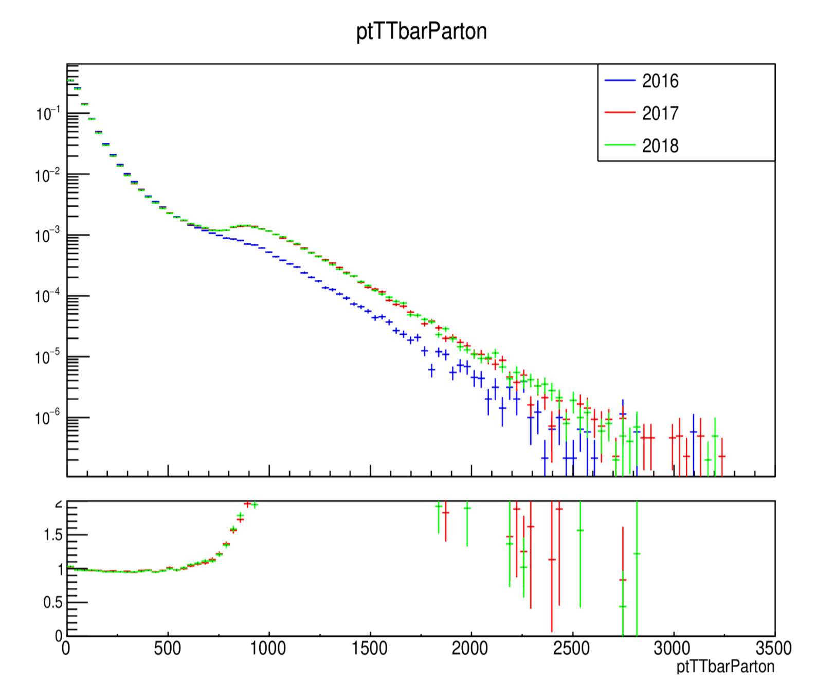
MC Closure tests ’16, ‘17 and ’18 (shape) for mtt files

Slide 5
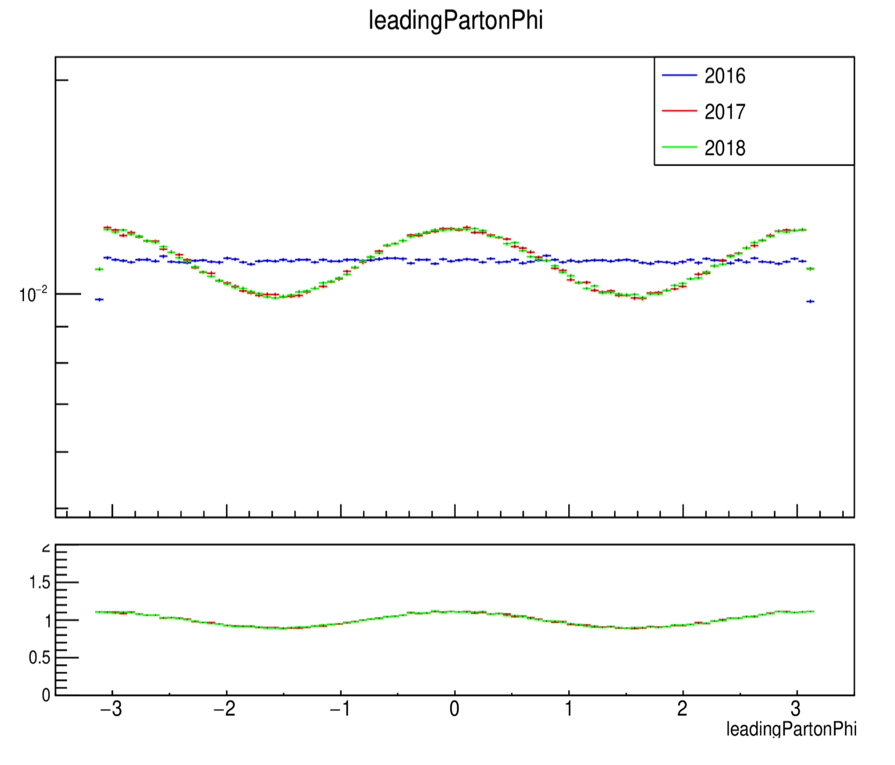
MC Closure tests ’16, ‘17 and ’18 (shape) for mtt files

Slide 6
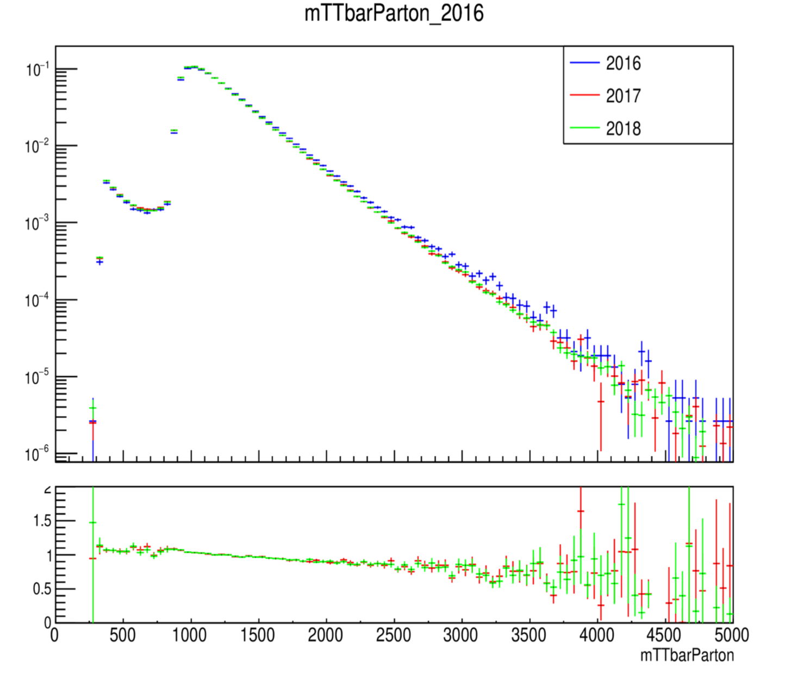
MC Closure tests ’16, ‘17 and ’18 (shape) nominal

Slide 7
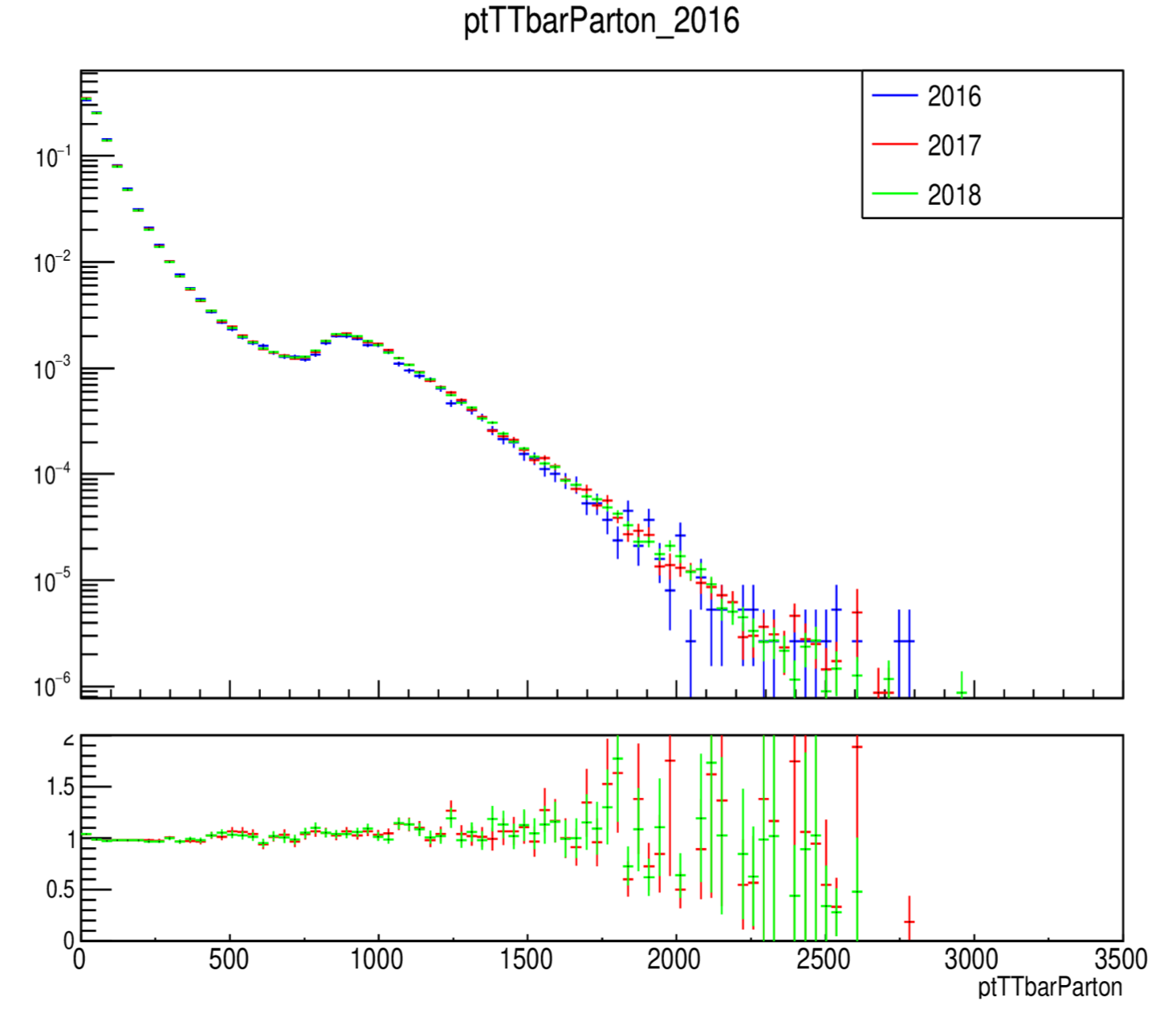
MC Closure tests ’16, ‘17 and ’18 (shape) nominal

Slide 8
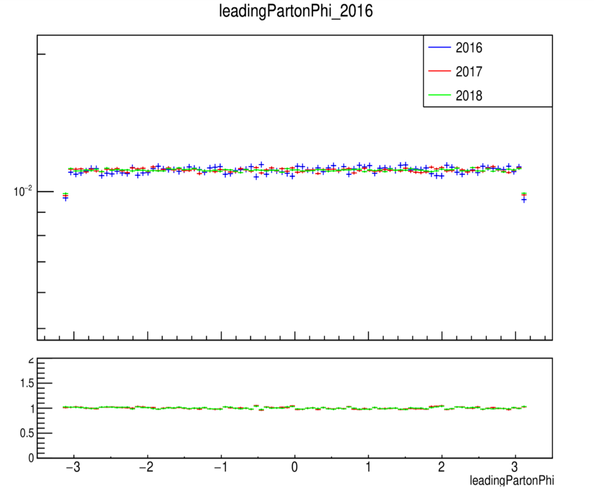
MC Closure tests ’16, ‘17 and ’18 (shape) nominal

Slide 9
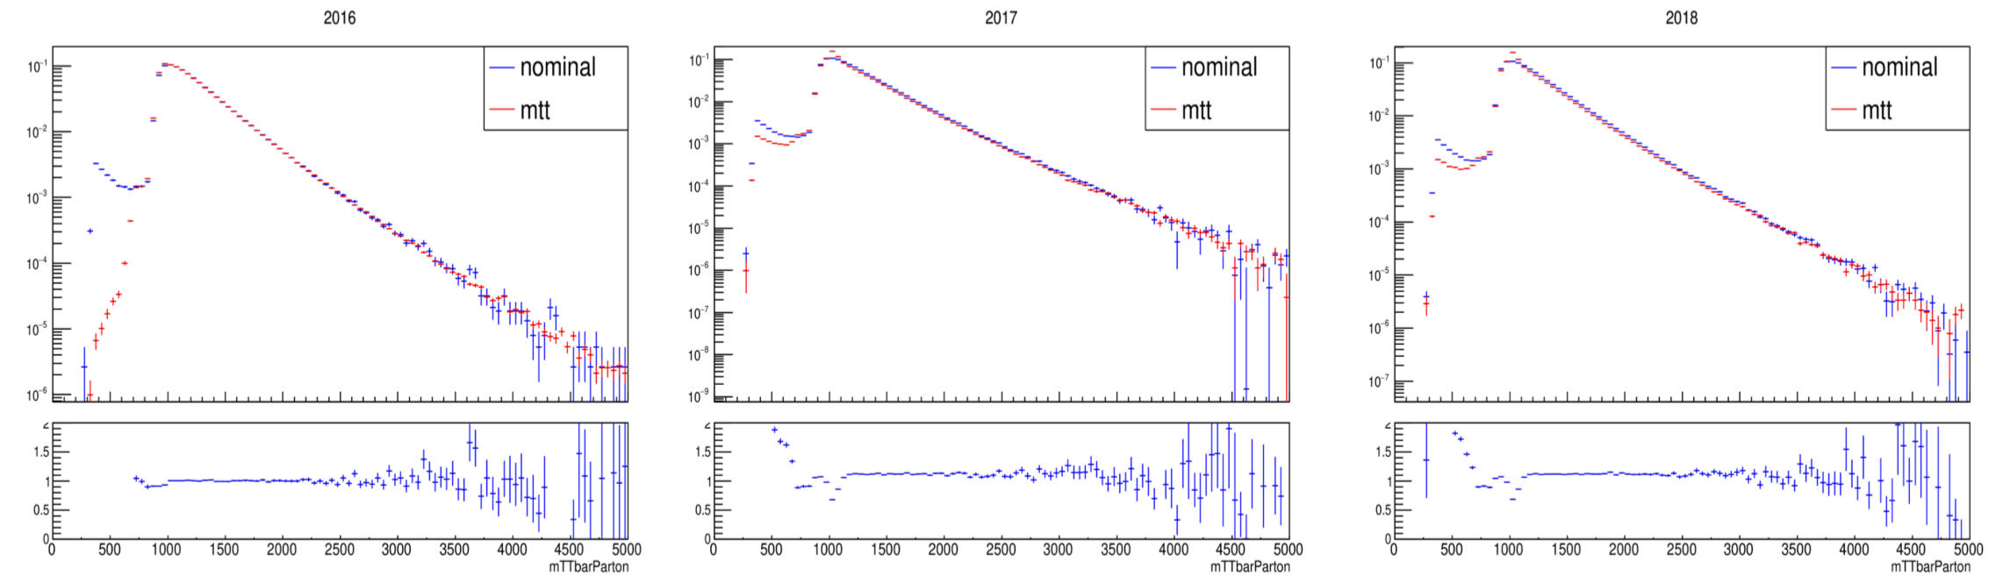
MC Closure Tests Mtt vs Nominal Parton

Slide 10
MC Closure Tests Mtt vs Nominal Parton

Slide 11
MC Closure Tests Mtt vs Nominal Parton

Slide 12
MC Closure Tests Nominal 2017 vs 2018 (shape) per slice

Slide 13
MC Closure Tests Nominal 2017 vs 2018 (shape) per slice

Slide 14
MC Closure Tests Nominal 2017 vs 2018 (shape) per slice

Slide 15
MC Closure Tests Nominal 2016 vs 2017 (shape) per slice

Slide 16
MC Closure Tests Nominal 2016 vs 2017 (shape) per slice

Slide 17
MC Closure Tests Nominal 2016 vs 2017 (shape) per slice

Slide 18
MC Closure Tests Nominal 2017 vs 2018 (shape) per slice Nominal

Slide 19
MC Closure Tests Nominal 2017 vs 2018 (shape) per slice Nominal

Slide 20
MC Closure Tests Nominal 2017 vs 2018 (shape) per slice Nominal

Slide 21
Efficiency from Nominal MC and High Mtt (corrected xsec) 2016

Slide 22
Efficiency from Nominal MC and High Mtt (1000-Inf File only) 2017

Slide 23
Efficiency from Nominal MC and High Mtt (1000-Inf File only) 2018

Slide 24
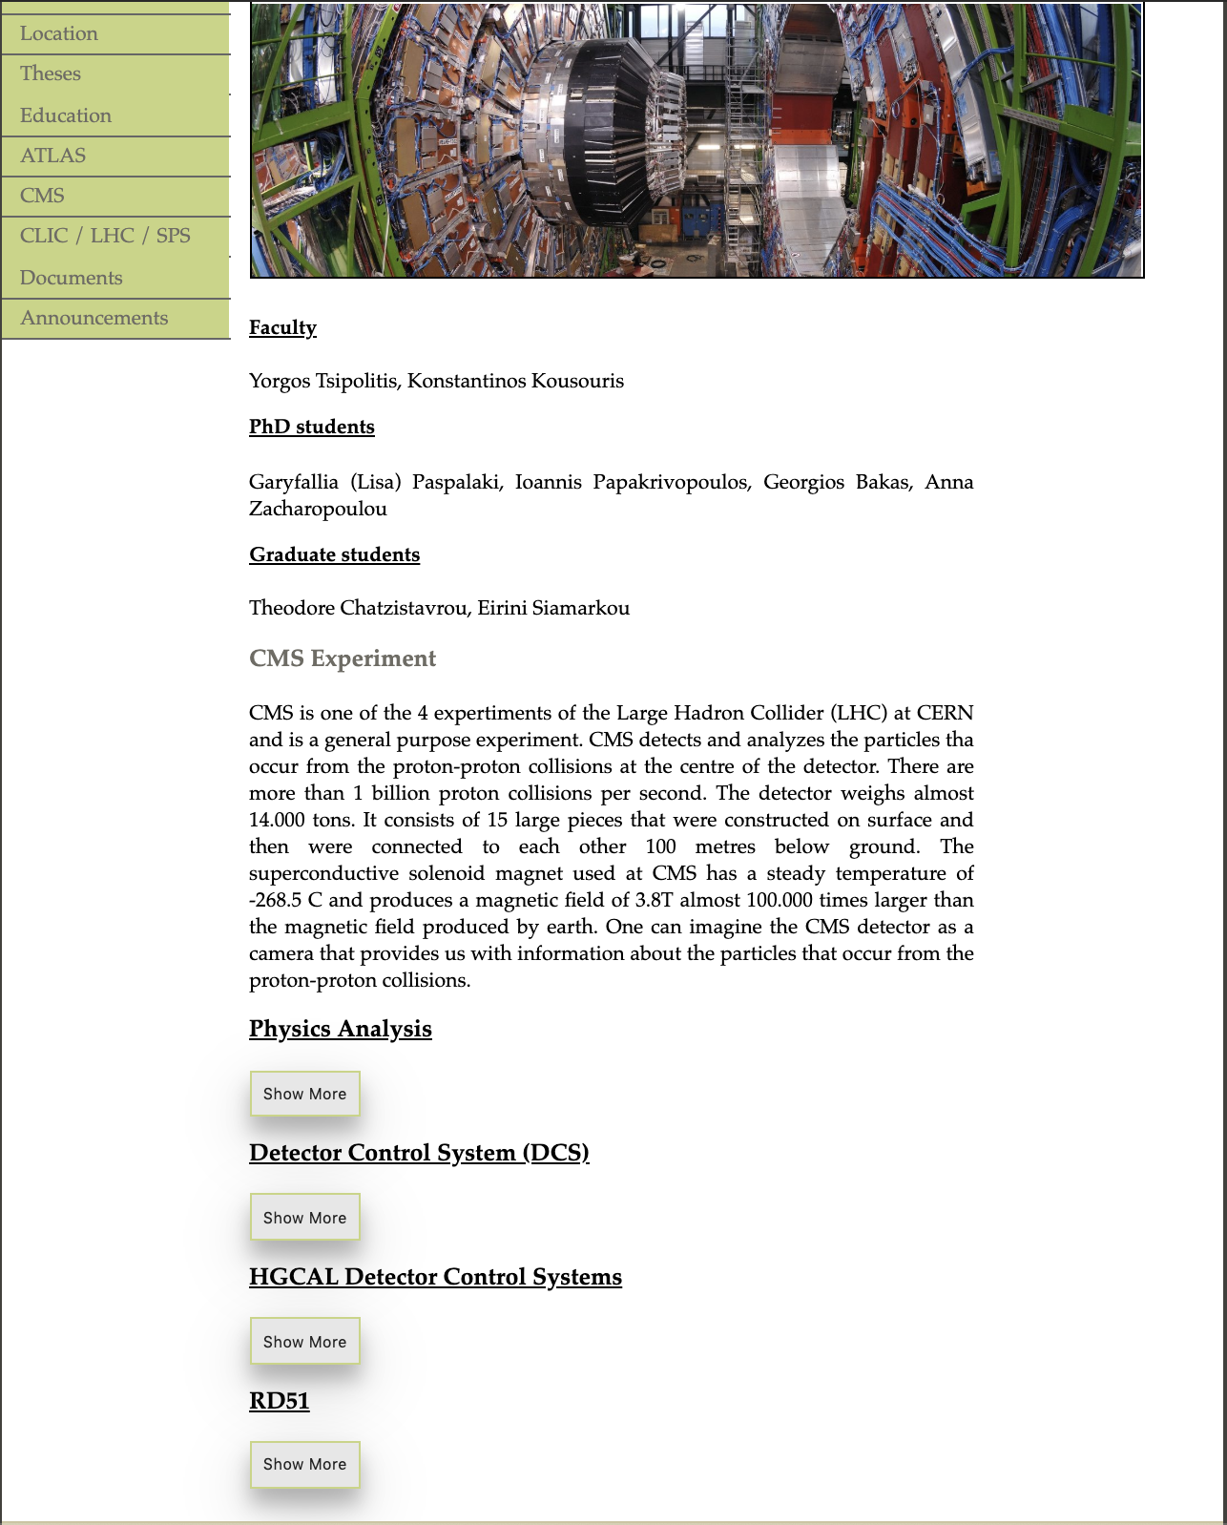
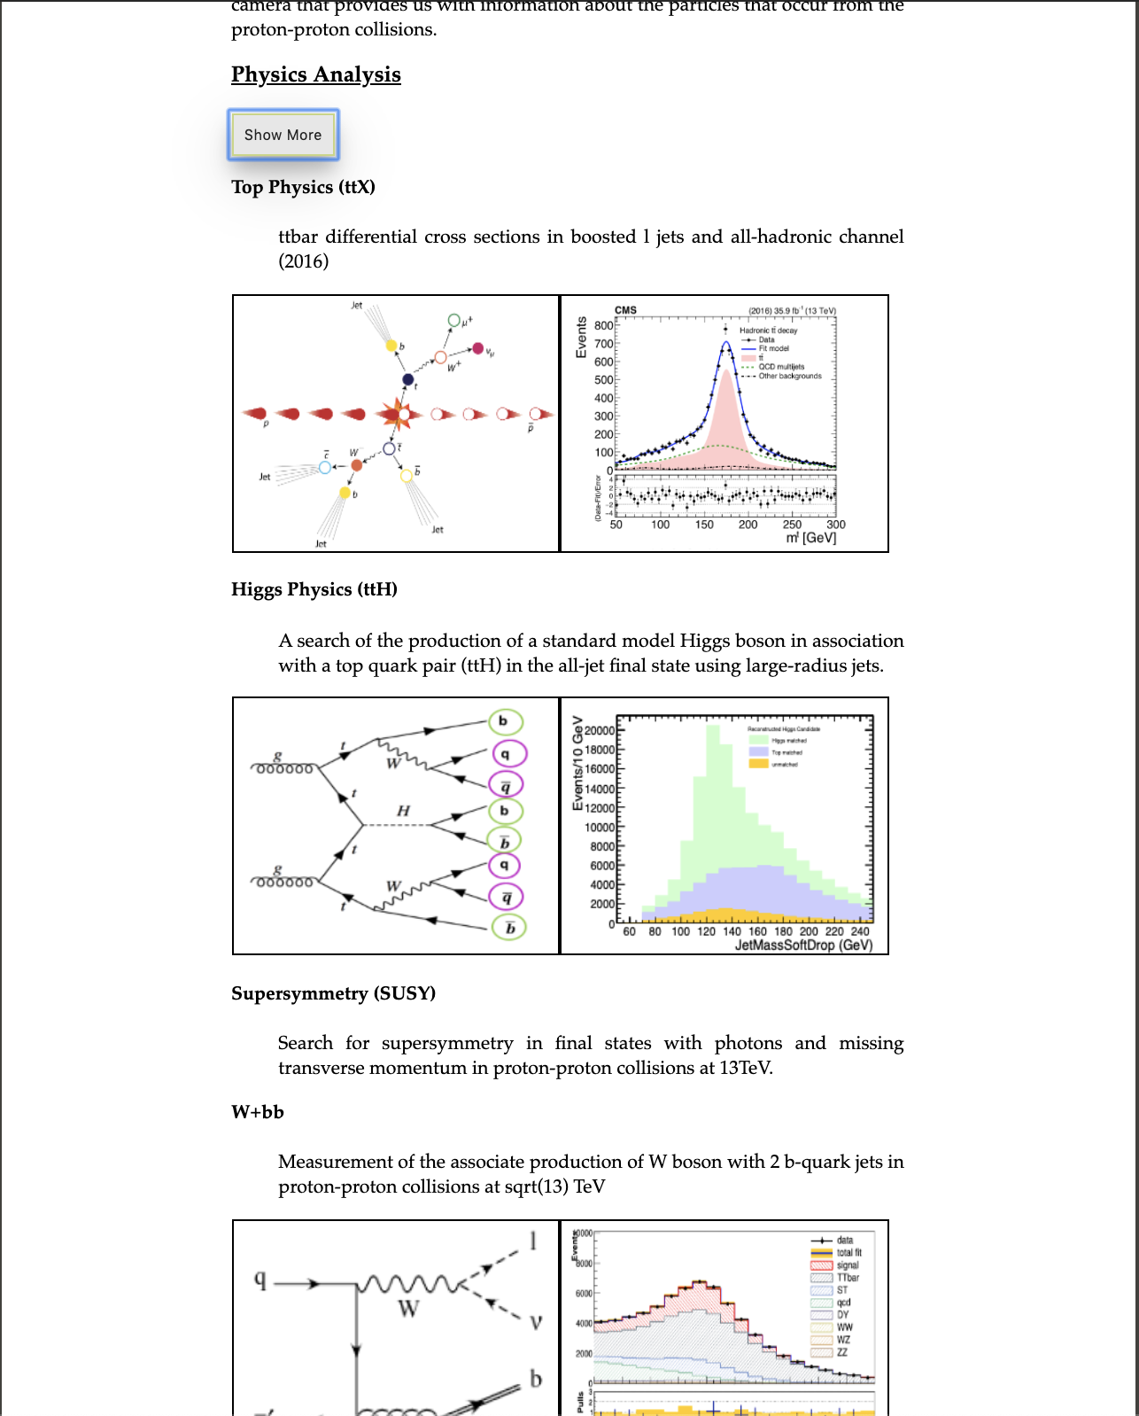
NTUA HEP Site

Slide 25
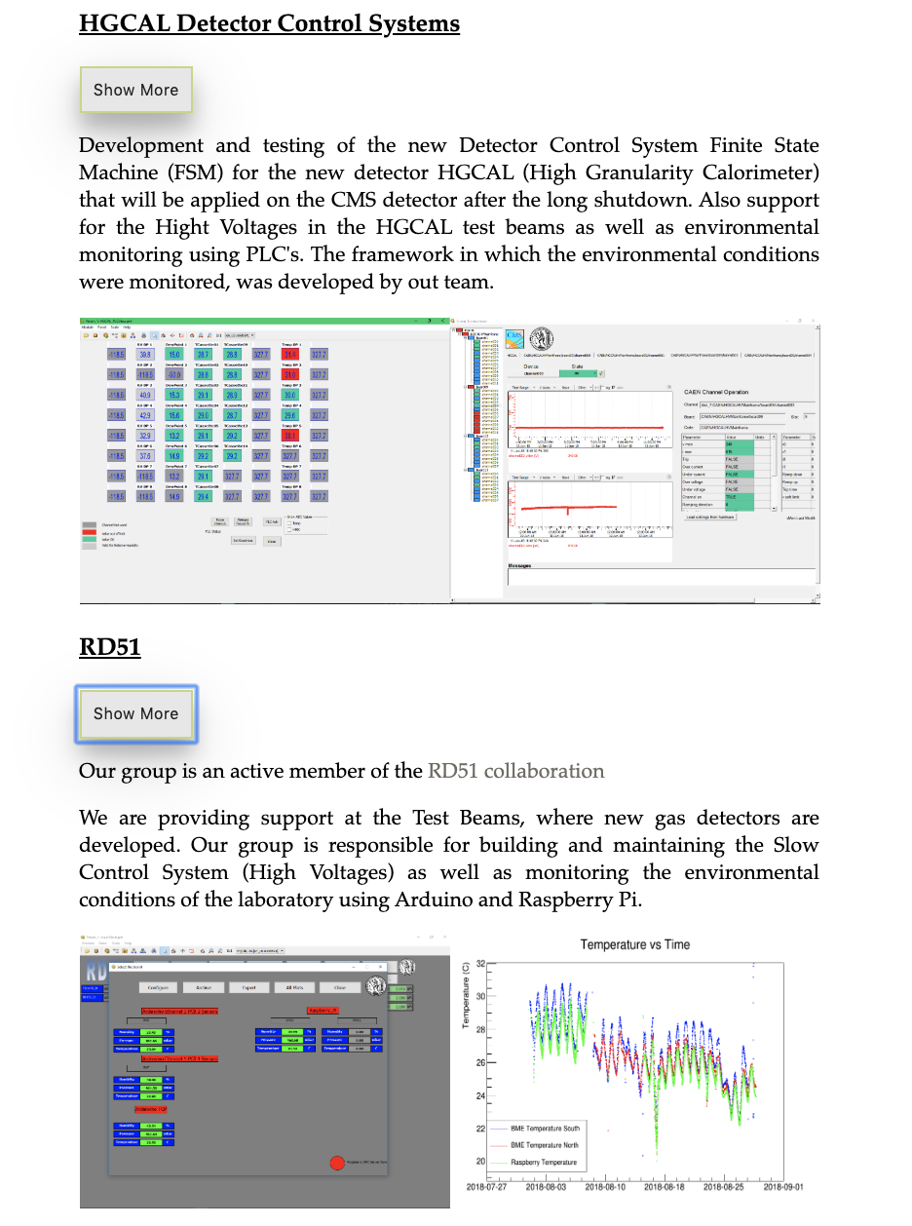
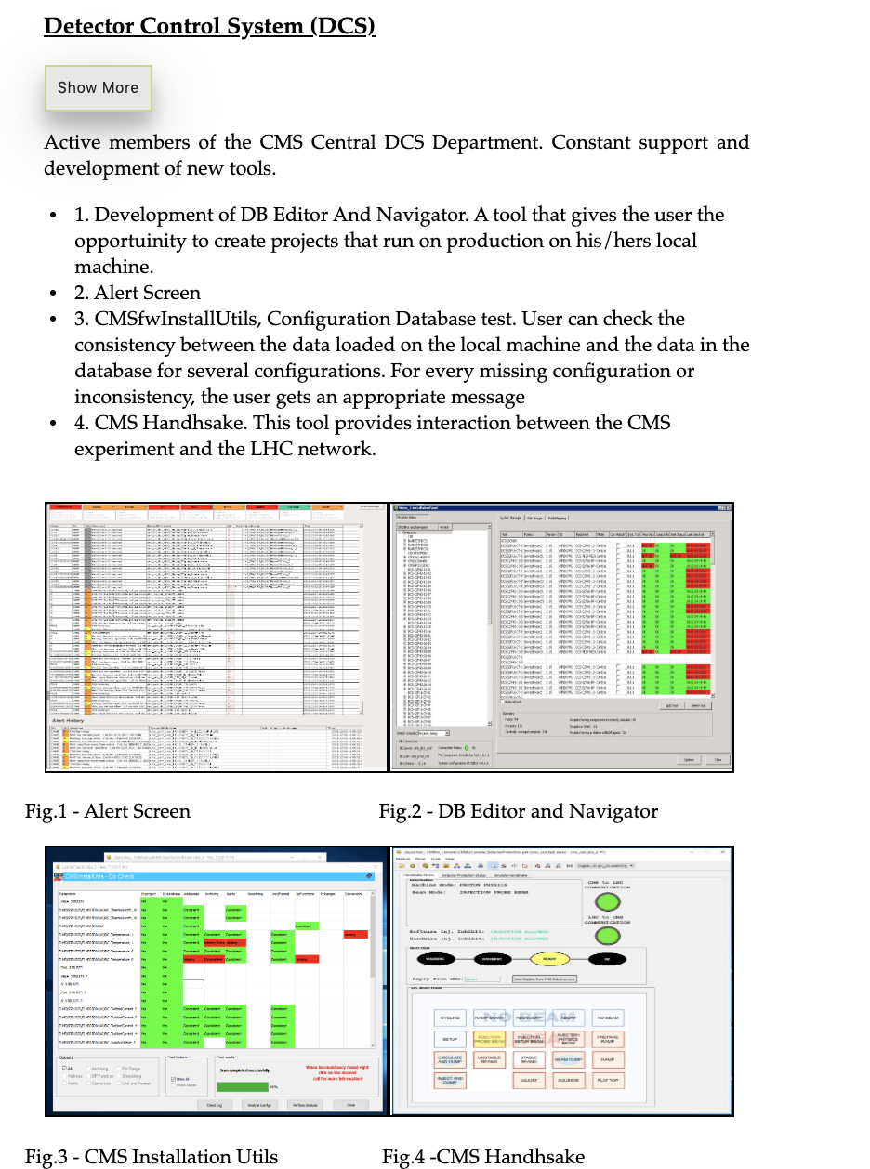
NTUA HEP Site

